Slide 1

Department of IT
Module : II Intermediate Code Generation and Memory Management
MS . G . VIDYASREE
CD : COMPILER DESIGN
Intermediate Code Generation and Memory Management

Slide 2
Outline :
Department of IT
Unit no : 2 Intermediate Code Generation and Memory Management
Role of Intermediate Code Generator Intermediate Languages
Directed Acyclic Graph (DAG)
Quadruple, Triples, Indirect Triples
SDD : Synthesized and Inherited Attribute Syntax Directed Translation
Activation Record Parameter Passing Methods

Slide 3
code.
🞄 In the analysis – synthesis model of compiler, the front end translates a source program into an intermediate representation from which the back end generates target
Role of Intermediate Code Generator
Intermediate
Parser
Static Checker
Intermediate Code Generator
Code
Code Generator
🞄 Source Program can be translated directly into machine language, some benefits of using a machine – independent intermediate form are :
Retargeting is facilitated ; a compiler for a different machine can be created by attaching a back end for the new machine to an existing front end.
A machine independent code optimizer can be applied to the intermediate representation.

Slide 4
Abstract Syntax Tree
Intermediate Language / Different Intermediate Form
Postfix notation
Three Address Code

Slide 5
🞄 Syntax Tree + DAG (Directed Acyclic Graph)
🞄 A syntax tree depicts the natural hierarchical structure of a source program.
🞄 A DAG (Directed Acyclic Graph) gives the same information
Abstract Syntax Tree
but in a more compact way because common
subexpressions are identified.
🞄 Example : a := b * -c + b * -c
=
=
+
+
a
a
*
*
*
b
uminus b
uminus
b
uminus
c
c
c

Slide 6
Postfix Notation
Postfix notation is a linearized representation of a syntax tree; it is a list of the nodes of the tree in which a node appears immediately after its children.
For example : a + b * c Postfix notation : bc*
a bc* +
🞄 Example : a := b * -c + b * -c
Postfix notation : a b c uminus * b c uminus * + =

Slide 7
🞄 Three address code is a sequence of statements of the general form
Three Address Code
x := y op z
Where x, y and z are names, constants, or compiler generated temporaries ; op stands for any operator, such as fixed or floating point arithmetic operator, or a logical operator on a Boolean data value.
🞄 Thus a source language expression like x + y translated into a sequence
t1 := y * z
t2 := x + t1
* z might be
Where t1 and t2 are compiler generated temporary names
🞄 Three address code is a linearized representation of a syntax tree or a DAG in which explicit names correspond to the interior nodes of the graph.

Slide 8
t1 := uminus c
Three Address Code
🞄 Example : a := b * -c + b * -c
t2 := b * t1
t3 := uminus c t4 := b * t3
t5 = t2 + t4 a = t5
🞄 The reason for the term “Three Address Code” is that each statement usually contains three addresses, two for the operands and one for the result.

Slide 9
🞄 It does not contain any cycles in it, hence called Acyclic.
Directed Acyclic Graph
🞄 Each Node of DAG contains a unique value.
Example : a = a + 10
=
Representation
1 | id | Entry to a
2 | Num | 10
3 | + | 1 | 2
4 | = | 1 | 3
+
a
10

Slide 10
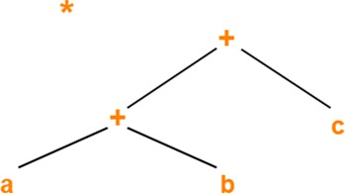
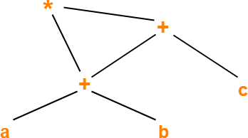
1) ( a + b ) * ( a + b + c )
Directed Acyclic Graph Examples

Slide 11
Directed Acyclic Graph Examples (Self Practice)
2) a + a * (b - c ) + ( b - c ) * d
3) i = i + 10
4) ( ( ( a + a ) + ( a + a ) ) + ( ( a + a ) + ( a + a ) ) )

Slide 12
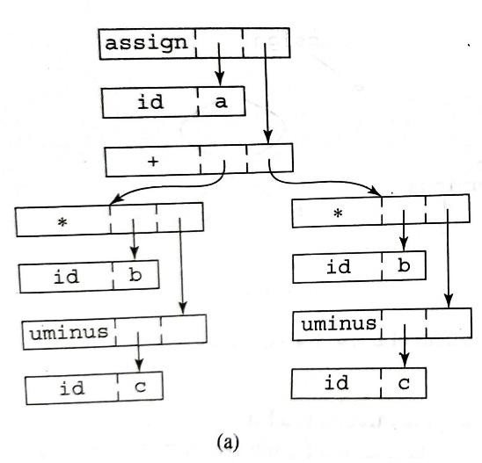
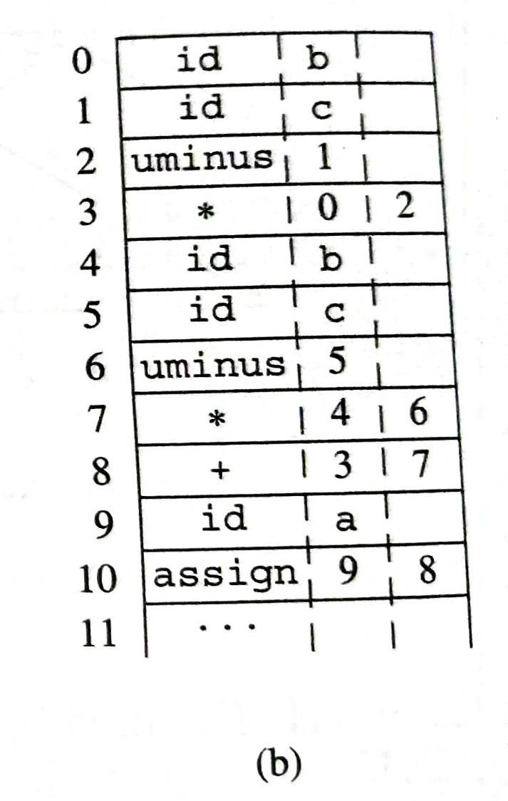
Representation of Syntax Tree a := b * -c + b * -c

Slide 13
🞄 A three address statement is an abstract form of intermediate code.
Quadruple, Triples and Indirect Triples
🞄 In a compiler, these statements can be implemented as records with fields for the operator and the operands.
🞄 Three such representations are
Quadruples
Triples
Indirect Triples

Slide 14
Quadruples :
🞄 A Quadruple is a record structure with four fields :
Op
Arg1
Arg2
Result
Implementations of Three- Address Statement
Quadruple, Triples and Indirect Triples
🞄 The address statement x := y op z is represented by
placing y in arg1 , z in arg2, and x in result.
🞄 Statements with unary operators like x := -y or x := y do not use arg2.
🞄 Conditional and unconditional jumps put the target label
in result.
🞄 The contents of fields arg1, arg2 and result are normally pointers to the symbol table entries for the names represented by these fields.
🞄 If so, temporary names must be entered into the symbol table as they are created.

Slide 15
Example
Quadruple, Triples and Indirect Triples
a := b * -c + b * -c
 | op | arg1 | arg2 | result
(0) | uminus | c |  | t1
(1) | * | b | t1 | t2
(2) | uminus | c |  | t3
(3) | * | b | t3 | t4
(4) | + | t2 | t4 | t5
(5) | := | t5 |  | a

Slide 16
🞄 To avoid creating temporary names into the symbol table, we might refer to a temporary value by the position of the statement that computes it.
Triples :
Quadruple, Triples and Indirect Triples
🞄 A Triple is a record structure with three fields :
Op
Arg1 Triples store operations and reference results using their position number instead of temporary variable
Arg2
🞄 Note that the copy statement a := t5 is encoded in the triple representation by placing a in the arg1 field and using the operator assign.
🞄 x [i] := y requires two entries in the triple structure.
 | op | arg1 | arg2
(0) | [ ] = | x | i
(1) | assign | (0) | y

Slide 17
Example
Quadruple, Triples and Indirect Triples
a := b * -c + b * -c
 | op | arg1 | arg2
(0) | uminus | c
(1) | * | b | (0)
(2) | uminus | c
(3) | * | b | (2)
(4) | + | (1) | (3)
(5) | := | a | (4)

Slide 18
🞄 Another implementation of three address code that has been considered is that of listing pointers to triples, rather than listing the triples themselves.
🞄 This implementation is naturally called indirect triples.
Indirect Triples :
Quadruple, Triples and Indirect Triples
 | Statement
(0) | (14)
(1) | (15)
(2) | (16)
(3) | (17)
(4) | (18)
(5) | (19)
 | op | arg1 | arg2
(14) | uminus | c
(15) | * | b | (14)
(16) | uminus | c
(17) | * | b | (16)
(18) | + | (15) | (17)
(19) | := | a | (18)

Slide 19
Practice Examples :
Quadruple, Triples and Indirect Triples
1) a * – (b + c)
2) a + b * c / e ↑ f + b * c
Quadruple
Location | Op | Arg1 | Arg2 | Result
(0) | ↑ | e | f | T1
(1) | * | b | c | T2
(2) | / | T2 | T1 | T3
(3) | * | b | c | T4
(4) | + | a | T3 | T5
(5) | + | T5 | T4 | T6

Slide 20
values of with the
Syntax Directed Definition
🞄 A syntax directed definition specifies the
attributes by associating semantic rules
grammar productions.
🞄 Grammar + Semantic Rules
🞄 A syntax-directed translation is an executable specification
of SDD.
🞄 Syntax directed definition is a generalization of context free grammar in which each grammar symbol has an associated set of attributes.
🞄 Types of attributes are:
Synthesized attribute
Inherited attribute

Slide 21
🞄 Value of synthesized attribute at a node can be computed from the value of attributes at the children of that node in the parse tree.
Synthesized Attribute
🞄 Syntax directed definition that uses synthesized attribute exclusively is said to be S-attribute definition.
🞄 A parse tree for an S-attribute definition can always be annotated by evaluating the semantic rules for the attribute at each node bottom up, from the leaves to root.
🞄 An Annotated parse tree is a parse tree showing the value of the attributes at each node.
🞄 The process of computing the attribute values at the node is called Annotating or Decorating the parse tree.

Slide 22
🞄 Example: Simple desk calculator
Synthesized Attribute
Production | Semantic rules
L → E_{n} | Print (E.val)
E → E₁+T | E.val = E1.val + T.val
E → T | E.val = T.val
T → T₁ * F | T.val=T1.val*F.val
T → F | T.val=F.val
F → (E) | F.val=E.val
F → digit | F.val=digit.lexval

Slide 23
🞄 String: 3*5+4n;
L
🞄 Example: Simple desk calculator
Synthesized Attribute
Production | Semantic rules
L → E_{n} | Print (E.val)
E → E₁+T | E.val = E1.val + T.val
E → T | E.val = T.val
T → T₁ * F | T.val=T1.val*F. val
T → F | T.val=F.val
F → (E) | F.val=E.val
F → digit | F.val=digit.lexv al
n
E.val=19
+
T.val=4
E.val=15
T.val=15
F.val=4
*
digit.lexval=4
T.val=3
F.val=5
F.val=3
digit.lexval=5
digit.lexval=3
Annotated parse tree for 3*5+4n

Slide 24
🞄 An inherited attribute at a node in a parse tree is defined in terms of attributes at the parent and/or siblings of the node.
Inherited Attribute
🞄 Convenient way of expressing the dependency of a programming language construct on the context in which it appears.
🞄 We can use inherited attributes to keep track of whether an identifier appears on the left or right side of an assignment to decide whether the address or value of the assignment is needed.
🞄 The inherited attribute distributes type information to the various identifiers in a declaration.

Slide 25
Inherited Attribute
Production | Semantic rules
D→TL | L.in = T.type
T → int | T.Type = integer
T → real | T.type= real
L → L1,id | L1.in = L.in, addtype(id.entry,L.in)
L → id | addtype(id.entry,L.in)
Symbol T is associated with a synthesized attribute type.
Symbol L is associated with an inherited attribute in.

Slide 26
real id1,id2,id3
Producti on | Semantic rules
D→TL | L.in = T.type
T → int | T.Type = integer
T → real | T.type= real
L → L1,id | L1.in = L.in, addtype(id.entry,L.in)
L → id | addtype(id.entry,L.in)
Inherited Attribute
D
L.in=real
T.type=real
L
real
,
L.in=real
id3
L₁
id
,
L.in=real
id2
L₁
id
id1
id
L → id D→TL
L → L₁ , id

Slide 27
Difference
Synthesized attribute | Inherited attribute
Value of synthesized attribute at a node can be computed from the value of attributes at the children of that node in parse tree. | Values of inherited attribute at a node can be computed from the value of attribute at the parent and/ or siblings of the node
Pass the information from bottom to top in the parse tree | Pass the information top to bottom in the parse tree or from left siblings to the right siblings.
Synthesized attribute is used by both S-attributed SDT and L- attributed STD. | Inherited attribute is used by only L-attributed SDT.

Slide 28
🞄 A compiler must accurately implement the abstractions embodied in the source language definition. These
Run time Environment
abstractions typically include the concepts such as
names, scopes, bindings, data types, operators,
procedures, parameters, and flow-of-control constructs.
🞄 The compiler must cooperate with the operating system and other systems software to support these abstractions on the target machine.
🞄 To do so, the compiler creates and manages a run-time environment in which it assumes its target programs are being executed.

Slide 29
🞄 A Procedure definition is a declaration that associates an identifier with a statement.
1. Procedure Call:-
Source Language Issue
🞄 The identifier is the procedure name and the statement is the procedure body.
🞄 For example, the following is the definition of procedure
named readarray :
Procedure readarray;
var I : integer; begin
For i := 1 to 9 read(a[i])
end;
🞄 When procedure name appears within an executable statement, the procedure is said to be called at that point.

Slide 30
🞄 Each execution of a procedure body is referred to as an activation of the procedure.
2. Activation tree
Source Language Issue
🞄 The lifetime of an activation of a procedure p is the sequence of steps between the first and last steps in the execution of the procedure body.
🞄 An activation tree is used to depict the way control enters and leaves activations. In an activation tree,
Each node represents an activation of a procedure.
The root represents the activation of the main program.
The node for a is the parent of the node for b if and only if control flows from activation a to b.
The node for a is to the left of the node for b if and only if the lifetime of a occurs before the lifetime of b.

Slide 31
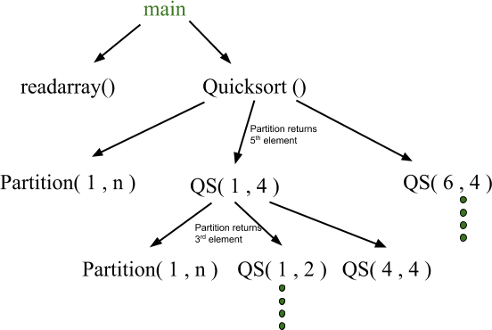
Source Language Issue

Slide 32
🞄 The flow of control in a program corresponds to a depth first traversal of the activation tree that starts at the root, visits a node before its children, and recursively visits children at each node in a left to right order.
3. Control Stack
Source Language Issue
🞄 A control stack is used to keep track of live procedure activations.
🞄 The idea is to push the node for an activation onto the control stack as the activation begins and to pop the node when the activation ends.
🞄 The contents of the control stack are related to paths to the root of the activation tree.
🞄 When node n is at the top of control stack, the stack
contains the nodes along the path from n to the root.

Slide 33
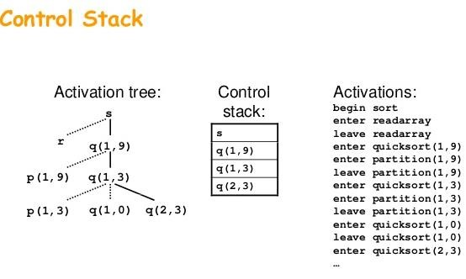
Source Language Issue

Slide 34
🞄 A declaration is a syntactic construct that associates information with a n Declarations may be explicit, such as: var i : integer ;
4. The Scope of a Declaration
Source Language Issue
🞄 Or they may be implicit.
🞄 Example, any variable name starting with I is assumed to denote an integer in a Fortran program unless otherwise declared.
🞄 The portion of the program to which a declaration applies is called the scope of that declaration.
🞄 An occurrence of a name in procedure is said to be local to the procedure if it is in the scope of a declaration within the procedure ; otherwise , the occurrence is said to be non local.

Slide 35
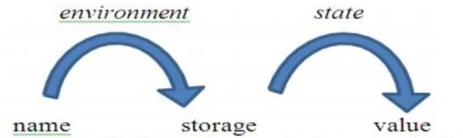
🞄 Even if each name is declared once in a program, the same
5. Binding of names
Source Language Issue
name may denote different data objects at run time.
🞄 “Data object” corresponds to a storage location that holds values.
🞄 The term environment refers to a function that maps a name to a storage location.
🞄 The term state refers to a function that maps a storage
location to the value held there.
🞄 When an environment associates storage location s with a name x, we say that x is bound to s.
🞄 This association is referred to as a binding of x.

Slide 36
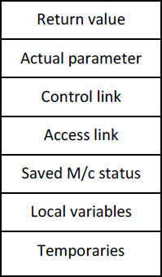
🞄 The activation record is a block of memory used for managing information needed by a single execution of a procedure.
Activation Record
Activation record
🞄 Fortran uses the static data area to store the activation record where as in pascal and C the activation record is situated in stack area.

Slide 37
Temporary values: The temporary variables are needed during the evaluation of expressions. Such variables are stored in the temporary field of activation record.
Local variable: The local data is a data that is local to the execution of procedure which is stored in this field of activation record.
Saved machine register: This field holds the information regarding the status of machine just before the procedure is called. This field contains the machine registers and program counters.
Control link: This field is optional. It points to the activation record of the calling procedure. This link is also called the dynamic link.
Access link: This field is also optional. It refers to the non local data in other activation record. This field is also called static link field.
Activation Record

Slide 38
6. Actual parameter: This field holds the information of actual parameter. These actual parameter are passes to the called procedure.
Activation Record
7. Return values: This field is used to store the result of a function call.

Slide 39
Static memory and Dynamic memory Allocation
Static memory allocation | Dynamic memory allocation
Memory is allocated before the execution of program begins. | Memory is allocated during the execution of program.
No memory allocation or de- allocation actions are performed during execution. | Memory bindings are established and destroyed during execution.
Execution speed is faster compared to dynamic allocation. | Execution speed is slower compared to static allocation.
To access the variable pointer is needed. | No need of dynamically allocated pointers.
More memory space is required as we allocate memory before execution. | Less memory space required in dynamic memory allocation.
Variable remains permanently allocated. | Allocated only when program unit is active.
Implemented using stack and heaps. | Implemented using data segment.

Slide 40
🞄 All programming languages have a notion of a procedure, but they can differ in how these procedures get their arguments. In this section, we shall consider how the actual parameters are associated with the formal parameters.
Parameter Passing Methods
Call by value
Call by reference
Copy restore
Call by name

Slide 41
1. Call by Value:
Parameter Passing Methods
🞄 In call-by-value, the actual parameter is evaluated (if it is an expression) or copied (if it is a variable). The value is placed in the location belonging to the corresponding formal parameter of the called procedure.
🞄 The operation in formal parameter do not change its value in actual parameter.
🞄 This method is used in C, Java and is a common option in
C++, as well as other languages.

Slide 42
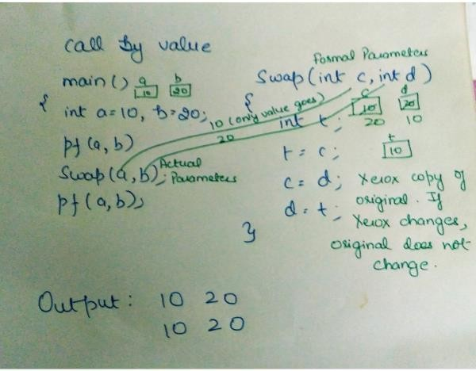
1. Call by Value:
Parameter Passing Methods

Slide 43
🞄 This method is also called call by address or call by
Parameter Passing Methods
2. Call by Reference:
location.
🞄 In call-by-reference, the address of the actual parameter is passed to the callee as the value of the corresponding formal parameter.
🞄 Uses of the formal parameter in the code of the callee are implemented by following this pointer to the location indicated by the caller.
🞄 Changes to the formal parameter thus appear as changes to the actual parameter.

Slide 44
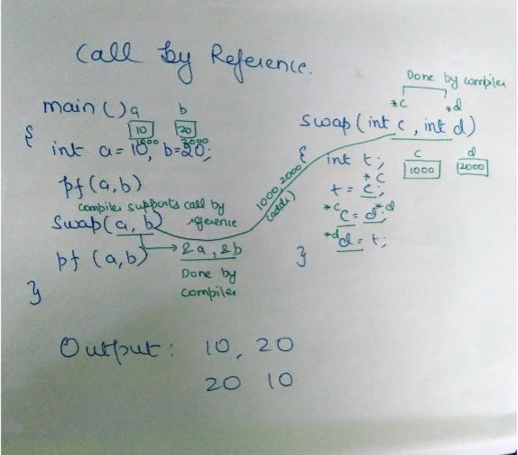
2. Call by Reference:
Parameter Passing Methods

Slide 45
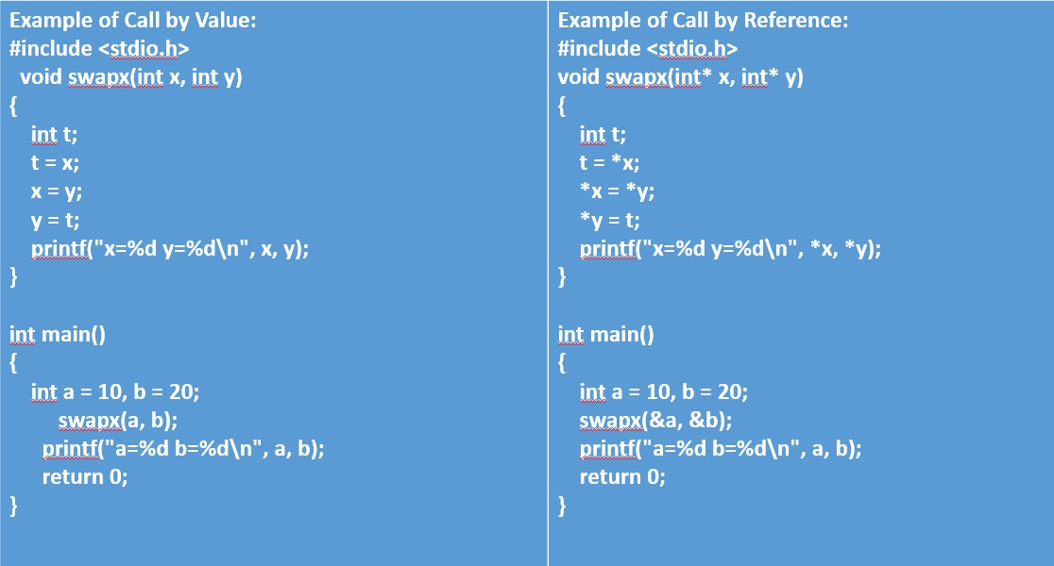
Parameter Passing Methods

Slide 46
Parameters
Call by Value
Call by Reference
A copy of the variable is passed.
A variable itself is passed.
Basic
Change in a copy of variable doesn’t modify the original value of variable.
Change in a copy of variable modify the original value of variable.
Parameter Passing Methods
effect
function_name(variabl e_name1,variable_nam e2…)
function_name(&varia ble_name1,&variable_ name2…)
Syntax
Primitive
types are passed using “call_by_value”.
Objects are implicitly passed using “call_by_reference”.
Default Calling

Slide 47
🞄 This method is hybrid between call by value and call by reference. This method is also called copy-in-copy-out or values result.
Parameter Passing Methods
3. Call by Copy - Restore:
🞄 The calling procedure calculates the value of actual parameter and it then copies to activation record for the called procedure.
🞄 During execution of called procedure, the actual parameters value is not affected.
🞄 If the actual parameter has X-values then, at return the value of formal parameter is copied to actual parameter.

Slide 48
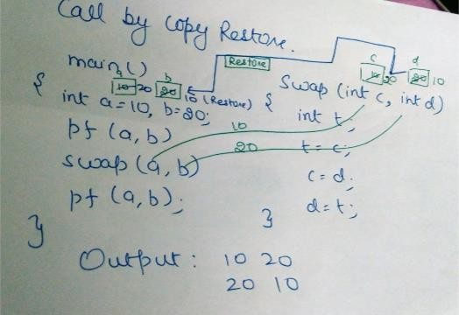
3. Call by Copy - Restore:
Parameter Passing Methods

Slide 49
🞄 This is less popular method of parameter passing.
Parameter Passing Methods
4. Call by Name:
🞄 Procedure is treated like macro. The procedure body is substituted for call in caller with actual parameters substituted for formulas.
🞄 The actual parameters can be surrounded by parenthesis to preserve their integrity.
🞄 The local names of called procedure and names of calling
procedure are distinct.

Slide 50
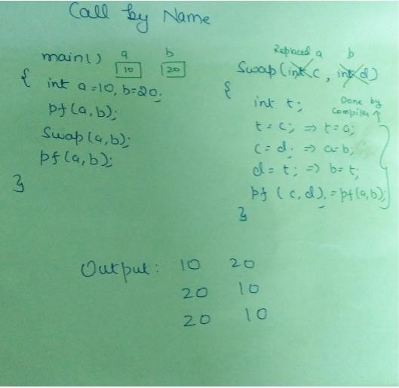
4. Call by name:
Parameter Passing Methods

Slide 51
Thanks

